Slide 1
Chapter two simple Searching and Sorting
By
Gedamu Alemu
alemugedamu@yahoo.com
Computer Vision and Image Processing SIG

Slide 2
Searching and Sorting
Topics
Sequential Search on an Unordered File
Sequential Search on an Ordered File
Binary Search
Selection Sort
Bubble Sort
Insertion Sort

Slide 3
Common Problems
There are some very common problems that we use computers to solve:
Searching through a lot of records for a specific record or set of records
Placing records in order, which we call sorting
There are numerous algorithms to perform searches and sorts. We will briefly explore a few common ones.

Slide 4
Searching
A question you should always ask
when selecting a search algorithm is
“How fast does the search have to be?”
The reason is that, in general, the faster the algorithm is, the more complex it is.
Bottom line: you don’t always need to use or should use the fastest algorithm.
following search algorithms, keeping speed in mind.
Sequential (linear) search
Binary search

Slide 5
Sequential Search on an Unordered File
Basic algorithm:
Get the search criterion (key)
Get the first record from the file
While ( (record != key) and (still more records) )
Get the next record
End_while
When do we know that there wasn’t a record in the file that matched the key?

Slide 6
Sequential Search on an Ordered File
Basic algorithm:
Get the search criterion (key)
Get the first record from the file
While ( (record < key) and (still more records) )
Get the next record
End_while
If ( record = key )
Then success
Else there is no match in the file
End_else
When do we know that there wasn’t a record in the file that matched the key?

Slide 7
Sequential Search of Ordered vs. Unordered List
Let’s do a comparison.
If the order was ascending alphabetical on customer’s name, how would the search for Yohannes on the ordered list compare with the search on the unordered list?
Unordered list
if Yohannes was in the list?
if Yohannes was not in the list?
Ordered list
if Yohannes was in the list?
if Jo Yohannes was not in the list?

Slide 8
Ordered vs Unordered (con’t)
How about Zinash?
Unordered
if Zinash was in the list?
If Zinash was not in the list?
Ordered
if Zinash was in the list?
If Zinash was not in the list?
How about Afork?

Slide 9
Ordered vs. Unordered (con’t)
Observation: the search is faster on an ordered list only when the item being searched for is not in the list.
Also, keep in mind that the list has to first be placed in order for the ordered search.
Conclusion: the efficiency of these algorithms is roughly the same.
So, if we need a faster search, we need a completely different algorithm.
How else could we search an ordered file?

Slide 10
Binary Search
If we have an ordered list and we know how many things are in the list (i.e., number of records in a file), we can use a different strategy.
The binary search gets its name because the algorithm continually divides the list into two parts.

Slide 11
How a Binary Search Works
Always look at the center value. Each time you get to discard half of the remaining list.
Is this fast ?

Slide 12
How Fast is a Binary Search?
Worst case: 11 items in the list took 4 tries
How about the worst case for a list with 32 items ?
1st try - list has 16 items
2nd try - list has 8 items
3rd try - list has 4 items
4th try - list has 2 items
5th try - list has 1 item

Slide 13
How Fast is a Binary Search? (con’t)
List has 250 items
1st try - 125 items
2nd try - 63 items
3rd try - 32 items
4th try - 16 items
5th try - 8 items
6th try - 4 items
7th try - 2 items
8th try - 1 item
List has 512 items
1st try - 256 items
2nd try - 128 items
3rd try - 64 items
4th try - 32 items
5th try - 16 items
6th try - 8 items
7th try - 4 items
8th try - 2 items
9th try - 1 item

Slide 14
What’s the Pattern?
List of 11 took 4 tries
List of 32 took 5 tries
List of 250 took 8 tries
List of 512 took 9 tries
32 = 2⁵ and 512 = 2⁹
8 < 11 < 16 2³ < 11 < 2⁴
128 < 250 < 256 2⁷ < 250 < 2⁸

Slide 15
A Very Fast Algorithm!
How long (worst case) will it take to find an item in a list 30,000 items long?
2¹⁰ = 1024 2¹³ = 8192
2¹¹ = 2048 2¹⁴ = 16384
2¹² = 4096 2¹⁵ = 32768
So, it will take only 15 tries!

Slide 16
Lg n Efficiency
We say that the binary search algorithm runs in log₂ n time. (Also written as lg n)
Lg n means the log to the base 2 of some value of n.
8 = 2³ lg 8 = 3 16 = 2⁴ lg 16 = 4
There are no algorithms that run faster than lg n time.

Slide 17
Sorting
So, the binary search is a very fast search algorithm.
But, the list has to be sorted before we can search it with binary search.
To be really efficient, we also need a fast sort algorithm.

Slide 18
Common Sort Algorithms
Bubble Sort Heap Sort
Selection Sort Merge Sort
Insertion Sort Quick Sort
There are many known sorting algorithms. Bubble sort is the slowest, running in n² time. Quick sort is the fastest, running in n lg n time.
As with searching, the faster the sorting algorithm, the more complex it tends to be.
We will examine three sorting algorithms:
Selection Sort
Bubble sort
Insertion sort

Slide 19
Bubble sort
Compare each element (except the last one) with its neighbor to the right
If they are out of order, swap them
This puts the largest element at the very end
The last element is now in the correct and final place
Compare each element (except the last two) with its neighbor to the right
If they are out of order, swap them
This puts the second largest element next to last
The last two elements are now in their correct and final places
Compare each element (except the last three) with its neighbor to the right
Continue as above until you have no unsorted elements on the left

Slide 20
Bubble Sort Code
void bubble_sort(list[])
{
int i,j,temp;
for(i=0;i<n; i++){
for(j=n-1;j>i; j--){
if(list[j]<list[j-1]){
temp=list[j];
list[j]=list[j-1];
list[j-1]=temp;
}//swap adjacent elements
}//end of inner loop
}//end of outer loop
}//

Slide 21
Analysis of Bubble Sort
How many comparisons?
(n-1)+(n-2)+…+1= O(n²)
How many swaps?
(n-1)+(n-2)+…+1= O(n²)
Space?
In-place algorithm.

Slide 22
Selection sort
Given an array of length n,
Search elements 0 through n-1 and select the smallest
Swap it with the element in location 0
Search elements 1 through n-1 and select the smallest
Swap it with the element in location 1
Search elements 2 through n-1 and select the smallest
Swap it with the element in location 2
Search elements 3 through n-1 and select the smallest
Swap it with the element in location 3
Continue in this fashion until there’s nothing left to search

Slide 23
Example and analysis of selection sort
The selection sort might swap an array element with itself--this is harmless, and not worth checking for
Analysis:
The outer loop executes n-1 times
The inner loop executes about n/2 times on average (from n to 2 times)
Work done in the inner loop is constant (swap two array elements)
Time required is roughly (n-1)*(n/2)
You should recognize this as O(n²)
7
2
8
5
4
2
7
8
5
4
2
4
8
5
7
2
4
5
8
7
2
4
5
7
8

Slide 24
Code for selection sort
void selection_sort(int list[])
{
int i,j, smallest;
for(i=0;i<n;i++){
smallest=i;
for(j=i+1;j<n;j++){
if(list[j]<list[smallest])
smallest=j;
}//end of inner loop
temp=list[smallest];
list[smallest]=list[i];
list[i]=temp;
} //end of outer loop
}//end of selection_sort

Slide 25
Analysis of Insertion Sort
How many comparisons?
(n-1)+(n-2)+…+1= O(n²)
How many swaps?
n=O(n)
How much space?
In-place algorithm

Slide 26
Insertion Sort
Insertion sort is slower than quick sort, but not as slow as bubble sort, and it is easy to understand.
Insertion sort works the same way as arranging your hand when playing cards.
Out of the pile of unsorted cards that were dealt to you, you pick up a card and place it in your hand in the correct position relative to the cards you’re already holding.

Slide 27
Arranging Your Hand
7
5
7

Slide 28
Arranging Your Hand
5
7
5
6
7
5
6
7
K
5
6
7
8
K

Slide 29
Insertion Sort
Unsorted - shaded
Look at 2nd item - 5.
Compare 5 to 7.
5 is smaller, so move 5 to temp, leaving
an empty slot in
position 2.
Move 7 into the empty
slot, leaving position 1
open.
Move 5 into the open
position.
7
K
1
7
5
v
7
5
7
>
2
5
7
3
<

Slide 30
Insertion Sort (con’t)
5
Look at next item - 6.
Compare to 1st - 5.
6 is larger, so leave 5. Compare to next - 7. 6 is smaller, so move 6 to temp, leaving an empty slot.
Move 7 into the empty
slot, leaving position 2
open.
Move 6 to the open
2nd position.
7
6
K
1
5
7
v
5
7
6
5
7
>
2
5
6
7
3
<

Slide 31
Insertion Sort (con’t)
Look at next item - King.
Compare to 1st - 5.
King is larger, so leave 5 where it is.
Compare to next - 6. King is larger, so leave 6 where it is.
Compare to next - 7. King is larger, so
leave 7 where it is.
5
6
7
K

Slide 32
Insertion Sort (con’t)
5
6
7
K
8
6
1
5
7
K
8
v
5
6
7
K
8
5
6
7
K
>
2
5
6
7
8
K
3
<

Slide 33
Code for Insertion Sort
void insertion_sort(int list[]){
int temp;
for(int i=1;i<n;i++){
temp=list[i];
for(int j=i; j>0 && temp<list[j-1];j--)
{ // work backwards through the array finding where temp should go
list[j]=list[j-1];
list[j-1]=temp;
}//end of inner loop
}//end of outer loop
}//end of insertion_sort

Slide 34
Analysis
How many comparisons?
1+2+3+…+(n-1)= O(n²)
How many swaps?
1+2+3+…+(n-1)= O(n²)
How much space?
In-place algorithm

Slide 35
Stack and Queue

Slide 36
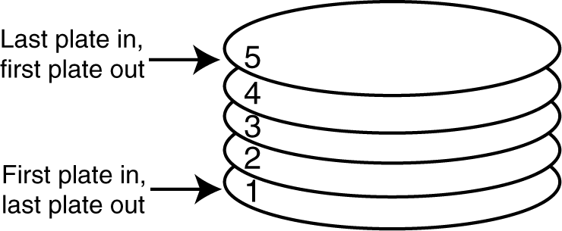
Stack
A stack is a data structure that stores and retrieves items in a last-in-first-out (LIFO) manner.
Computer systems use stacks during a program’s execution to store function return addresses, local variables, etc.
Some calculators use stacks for performing mathematical operations.

Slide 37
Stack …
Access is allowed only at one point of the structure, normally termed the top of the stack, so the operations are limited:
push (add item to stack)
pop (remove top item from stack)
top (get top item without removing it)
clear
isEmpty
size

Slide 38
Static and Dynamic Stack
Static Stacks
Fixed size
Can be implemented with an array
Dynamic Stacks
Grow in size as needed
Can be implemented with a linked list

Slide 39
Stack Operation: Push Operation
Push
value to be stored in (pushed onto) the stack
push(5);
push(10);
push(15);
The state of the stack after each of the push operations:

Slide 40
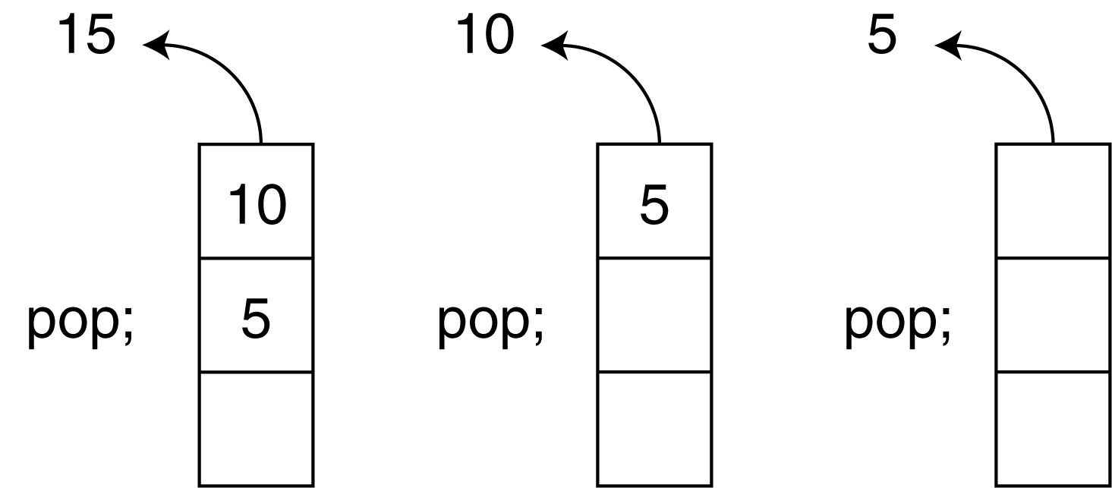
The Pop Operation
Retrieves and removes a value from the stack
suppose we execute three consecutive pop operations on the same stack:

Slide 41
Other Stack Operations
isFull:
A Boolean operation needed for static stacks. Returns true if the stack is full. Otherwise, returns false.
isEmpty:
A Boolean operation needed for all stacks. Returns true if the stack is empty. Otherwise, returns false.

Slide 42
Stack implementation : push operation
void push(){
int item;
if(top==MAX-1)
cout<<"Stack is Full";
else
{
cout<<"\nEnter Item to Push:";
cin>>item;
stack[++top]=item;
}
}

Slide 43
Stack implementation : pop ()
void pop()
{
if(top<0) cout<<"Stack is empty";
else
cout<<"Poped Item:"<<stack[top--];
}

Slide 44
Application area of stack
The simplest application of a stack is to reverse a word
Another application is an "undo" mechanism in text editors
Backtracking.
This is a process when you need to access the most recent data element in a series of elements
Language processing:
space for parameters and local variables is created internally using a stack.
compiler's syntax check for matching braces is implemented by using stack.
support for recursion
Expression Representation

Slide 45
Queue
A data structure that has access to its data at the front and rear.
operates on FIFO (Fast In First Out) basis.
uses two pointers/indices to keep tack of information/data.
has two basic operations:
enqueue - inserting data at the rear of the queue
dequeue – removing data at the front of the queue

Slide 47
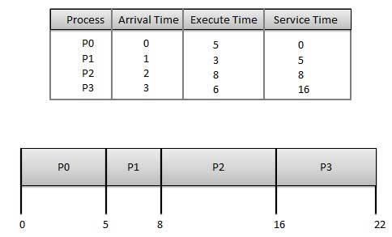
Application area :
Waiting for a particular event to occur.
Scheduling of processes.
First-Come, First-Served (FCFS) Scheduling
Priority Scheduling
Multiple-Level Queues Scheduling

Slide 48
Priority queue

Slide 49
Simple array implementation of enqueue and dequeue operations
Analysis:
Consider the following structure: int Num[MAX_SIZE];
We need to have two integer variables that tell:
the index of the front element
the index of the rear element
We also need an integer variable that tells:
the total number of data in the queue
int FRONT =-1,REAR =-1;
int QUEUESIZE=0;

Slide 51
Code part ….. Enqueue operation
void enqueue(){
if(rear>=MAX-1) cout<<"Q full";
else{
int item;
cout<<"enter Data";
cin>>item;
queue[++rear]=item;
if(front==-1) front++;
}

Slide 52
Code.. Dequeue opration
void dequeue(){
if(front==-1 ||front>rear)
cout<<"Q under flow";
else{
cout<<"Dequeue:"<<queue[front++];
}

Slide 53
Circular array
Problem in normal queue :
Circular queue:
freed spaces are re-used to store data

Slide 54
Analysis
Consider the following structure: int Num[MAX_SIZE];
We need to have two integer variables that tell:
The index of the front element
The index of the rear element
We also need an integer variable that tells:
The total number of data in the queue
int FRONT =-1,REAR =-1;
int QUEUESIZE=0;

Slide 56
Code

